Slide 1

A Quantitative Evaluation of Contemporary GPU Simulation Methodology
ACM SIGMETRICS 2018
Akshay Jain*
Mahmoud Khairy*
Tim Rogers
Accelerator Architecture Lab at Purdue
* Significant contributors
Electrical and Computer Engineering
June 21, 2018
Notes:
Hello, I will be presenting my work on GPU simulation that I performed in Acc Arch Lab at Purdue with Mahmoud and my advisor, Prof Rogers who is also present here.

Slide 2
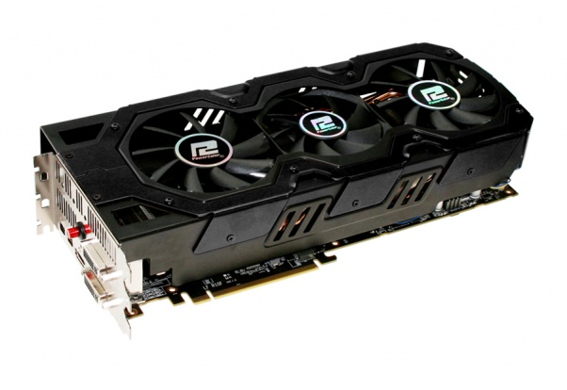
Simulation in Architecture
App1
App2
App1
App2
Building new hardware is expensive and slow
Create high level simulation models to mimic new hardware before its built.
Need to ensure simulation results are correlated to current hardware
Make sure the results can be trusted for future product decisions
Simulator
=
?
Notes:
If we say 20% better, then 20% better than what?
Performance is the primary goal

Slide 3
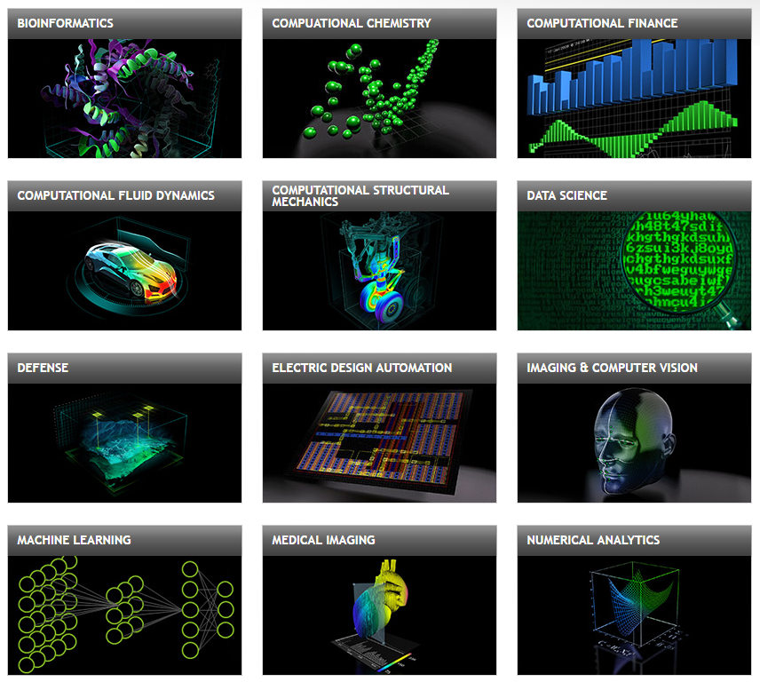
Introduction to GPU compute
GPU as compute devices
Modern GPUs used for accelerating compute workloads
Top 15 HPC applications use GPU (http://www.nvidia.com/content/intersect-360-HPC-application-support.pdf)
Better Energy Efficiency
Top 5 supercomputers on Green500 Jun17 use GPU
GPU architecture researchers rely on cycle level simulators for predicting performance on next gen GPUs.
Source: Nvidia.com
Notes:
Quick intro to compute
Introduce next slide

Slide 4
GPGPU-Sim
What is GPGPU-Sim?
GPGPU Architecture Simulator
Most widely used GPU simulator in academic research.
1100+ citations
Why correlate GPGPU-Sim?
Previous correlation with Nvidia Fermi GTX 480 (released in 2010)
Only for Instructions per cycle (IPC) for a limited set of benchmarks
First work to rigorously validate an open source GPU simulator.
Survey of GPU architecture papers published in ISCA, MICRO, HPCA and ASPLOS over the last four years
Notes:
More than 80% use GPGPU-Sim
Most of the others are proprietary simulators within the company
To evaluate where the simulator is accurate and where its not, we divide it into different categories and look at each category in detail.

Slide 5
Workloads
29 compute applications (that spawn a total of 1797 kernels) from Rodinia benchmark suite, Nvidia Cuda SDK, SHOC, Parboil and GPU Polybench.
Divided into four categories
Accesses have locality
Cache Sensitive
Compute Intensive
Compute Balanced
Streaming accesses
Memory Sensitive
Compute Bound
Memory Bound
Notes:
GPUs launch work in terms of kernels

Slide 6
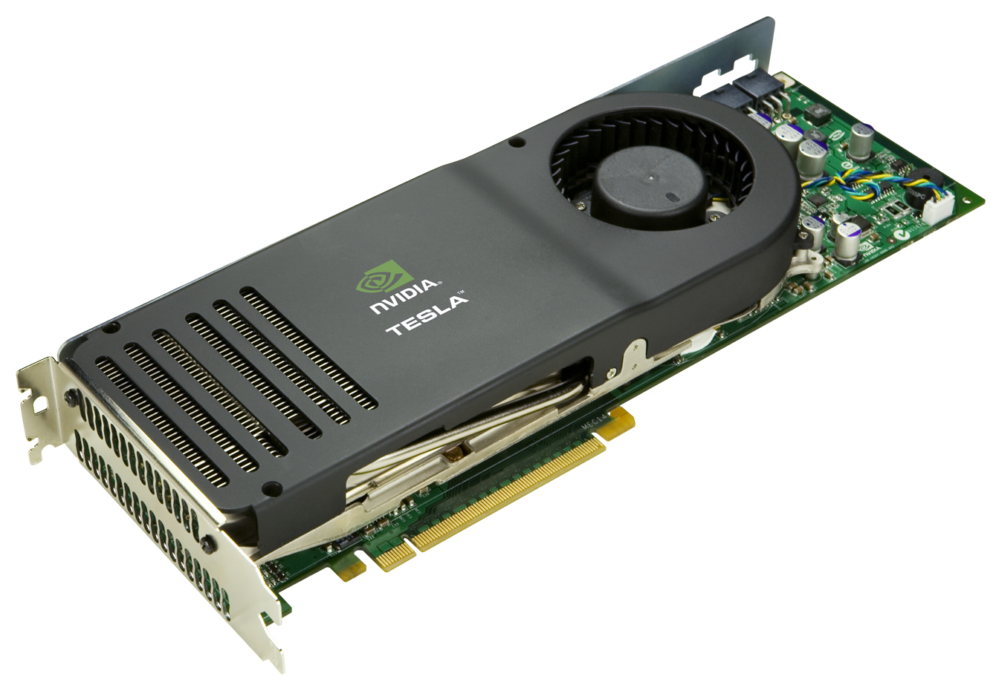
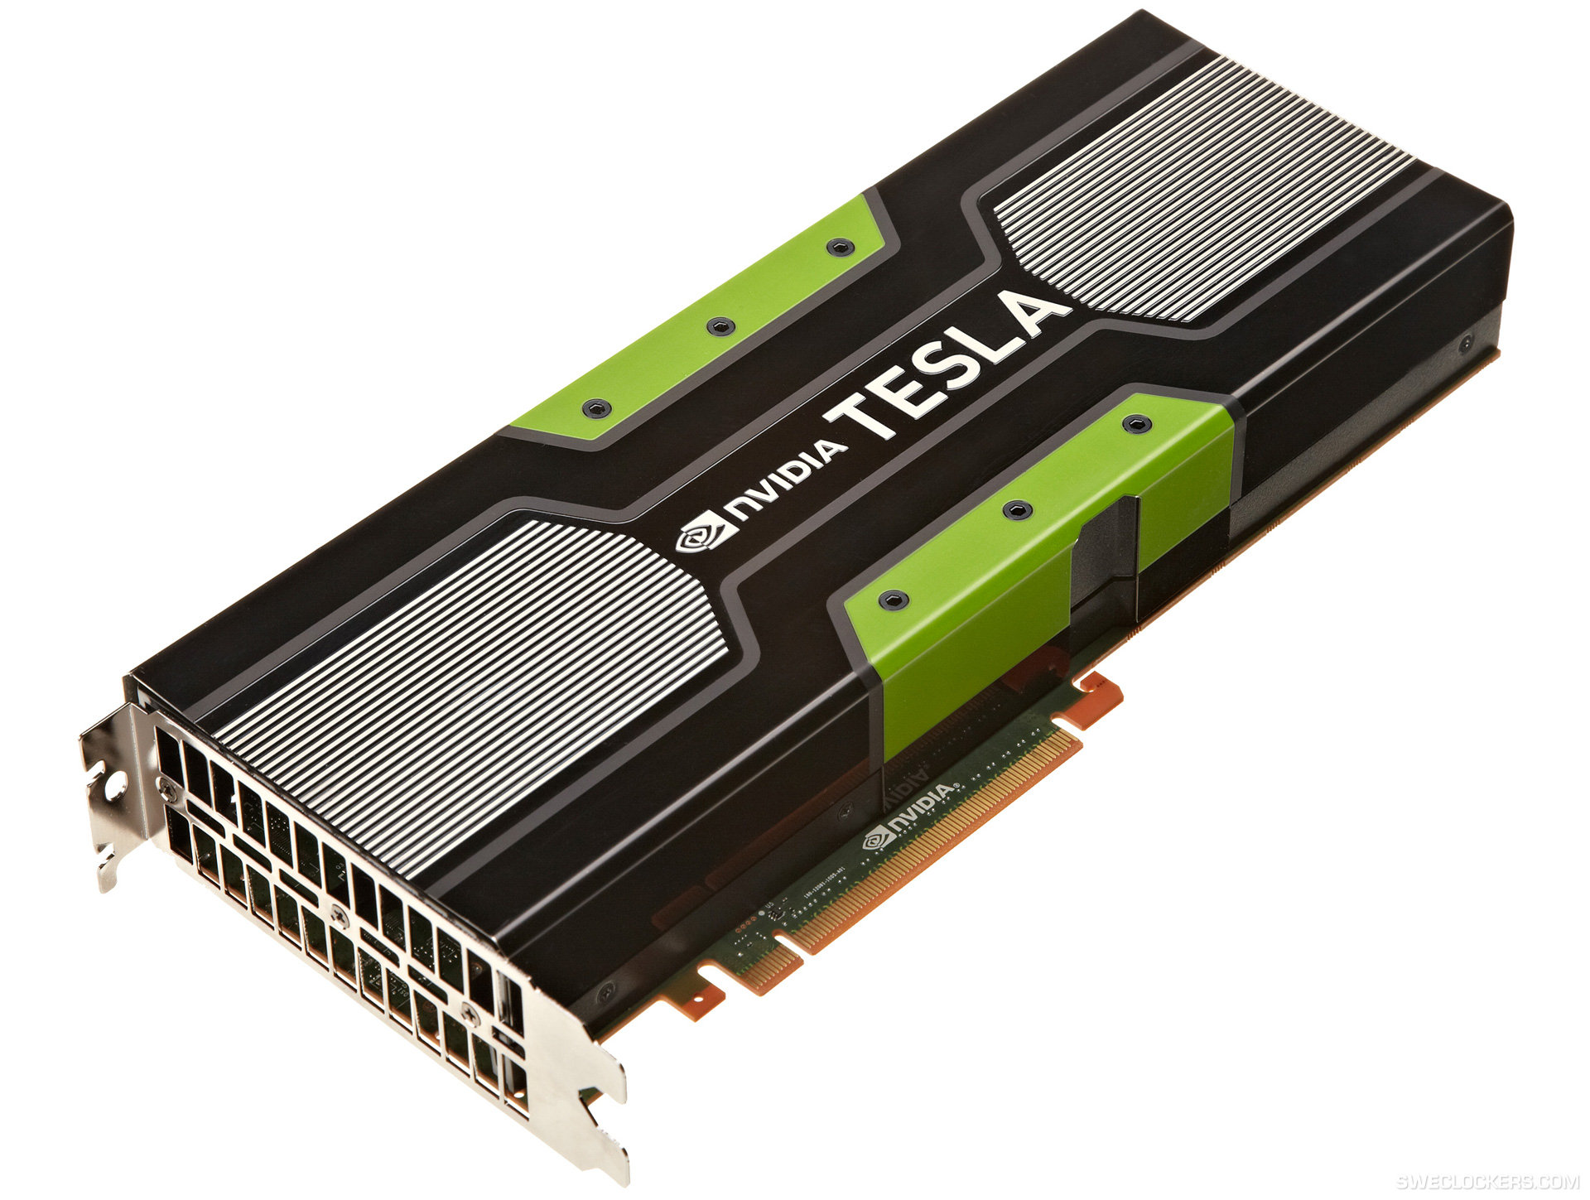
Two Step compile process in GPUs
GPGPU-Sim only supports 8 years old mISA
mISA1
arch1 ☑
x86 obj
compiler
mISA2
arch2 ☑
vISA
Proprietary
Machine specific
Register allocated
Optimized
Well documented
Abstract
No register allocation
Unoptimized
mISA1
mISA2
Source
arch3 ☒
Fat Binary
vISA
JIT
mISA3
arch3 ☑
Compile Time
Run Time
Notes:
Reverse engineering

Slide 7
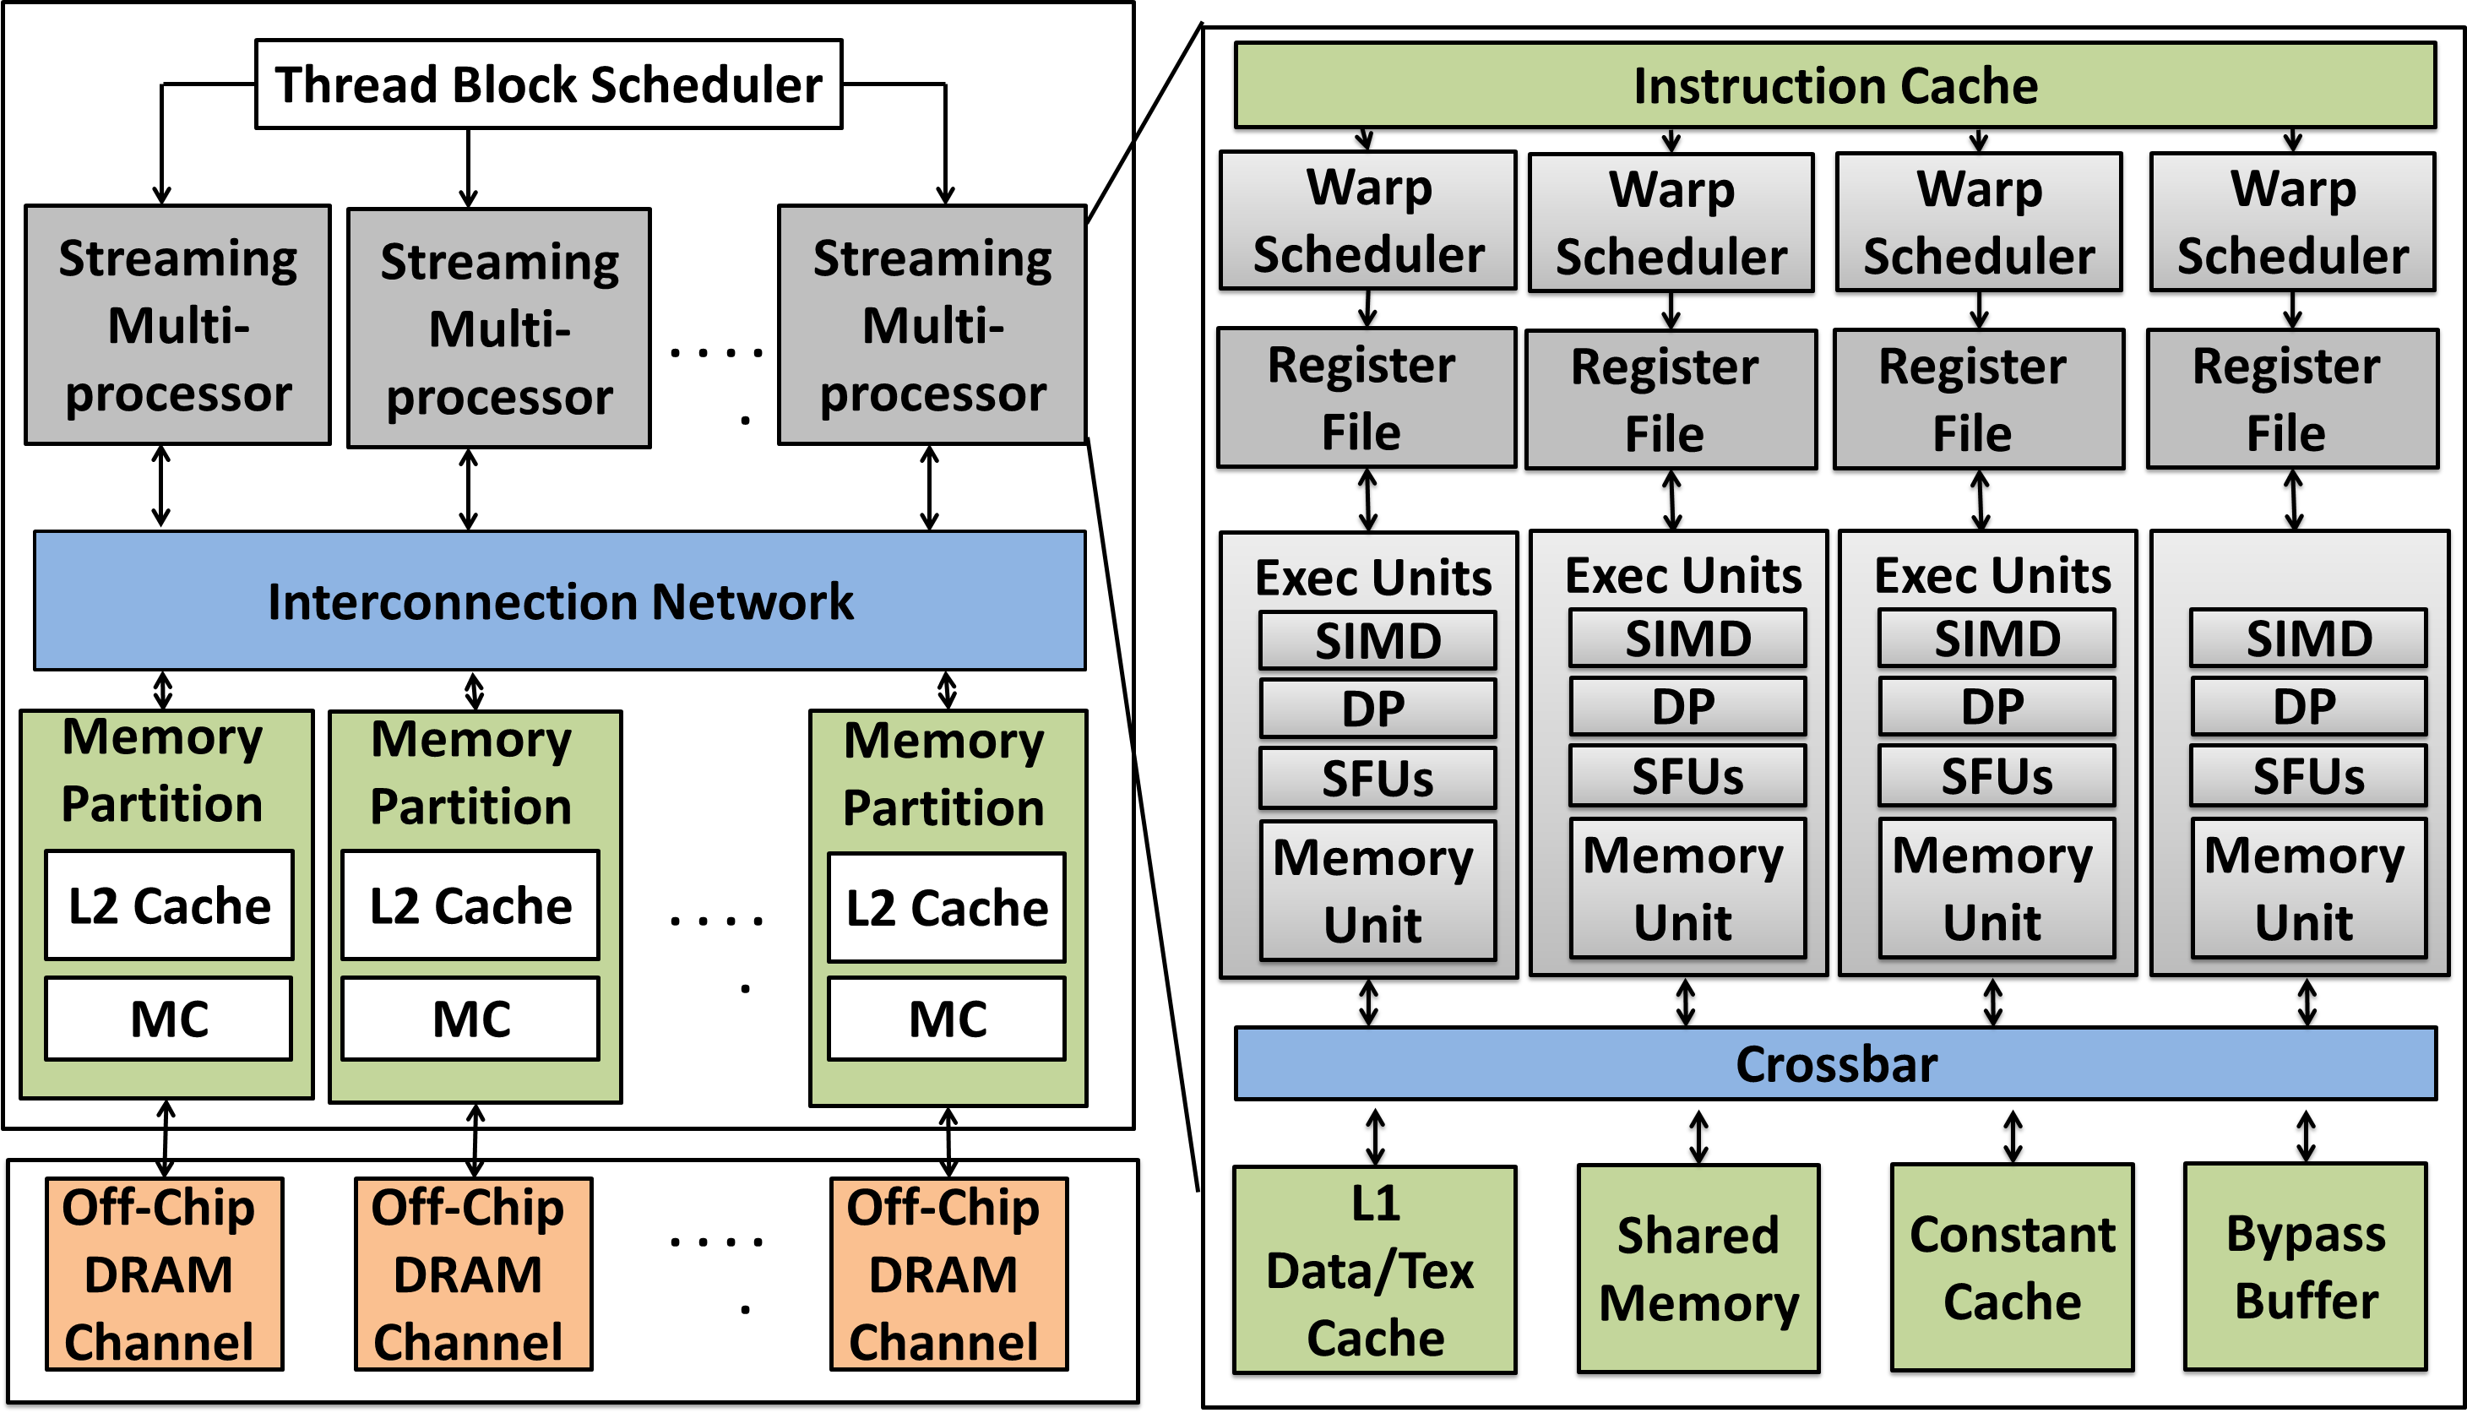
Pascal TITAN X correlation
Performance metrics correlated
System Analysis
Execution cycles
Warp instructions
GPU Core Analysis
SIMD utilization
L1 Instruction cache
Global Memory Requests and Divergence
Memory System Analysis
L2 cache accesses and hits
Memory Controller and DRAM
Nvidia Pascal TitanX architecture
Notes:
GPGPU sim models a full discrete GPU
We evaluate it on Pacal TitanX,
And we look at all layers of the system
the most modern Nv GPU available that time
Starting from inst front end to exec units all the way down to mem system and dram
Be brief

Slide 8
Metrics measured
Correlation
H | S
3 | 9
2 | 7
4 | 12
5 | 15
6 | 17
Correl | 99.7%
For two vectors,
H: hardware values
S: simulator values
The correlation is given by:
Error
Mean Absolute Percentage Error
Notes:
Corr allows you to look at the trends
Doesn’t tell the whole story
Absolute Error tells how far off the simulator actually is in absolute means

Slide 9
Experimental Results
Key Points
Compute intensive: old mISA is good
Cache sensitive: high error
Memory sensitive (streaming): low error
Compute balanced: vISA may be better
Notes:
Each of the 4 classifications have different errors and validation results
We’ll drill down into each of them separately

Slide 10
Compute Intensive apps: old mISA is good
Observations
Very high correlation and low error with mISA
mISA (even if old) is better than vISA
Notes:
X is hw
Y is simulator
Axes in log scale
Any point on Y=X tells us the simulated values perfectly match the values from hw
Orange dot is vISA, black dot is old mISA

Slide 11
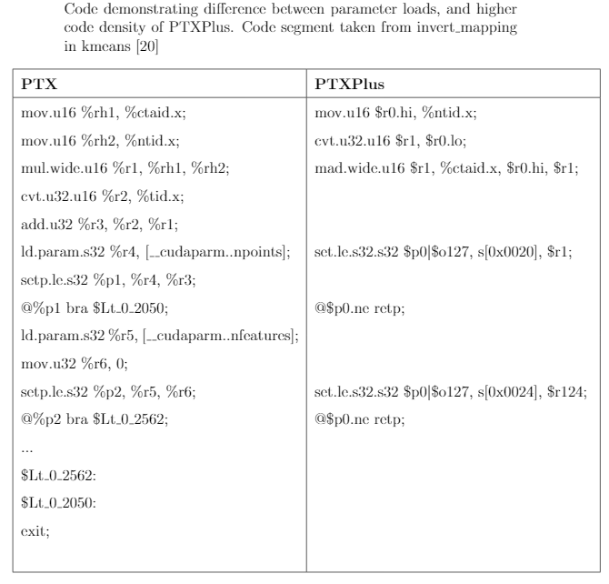
Code Example
old mISA.
vISA
Old mISA
INSTRUCTIONS EXECUTED
vISA
Notes:
Remove PTX/+

Slide 12
Cache Sensitive apps: high error
Observations
Low Correlation, high error
Inaccurate caching model wrt hardware
ISA doesn’t matter
Notes:
Relatively low correlation

Slide 13
Memory System needs remodeling
L2 ACCESSES
Memory atom size (L2 access granularity)
Simulator always generates 128B requests
HW generates1x/2x/4x requests suggesting a different request size
Notes:
This is a ramification of the cache sens having high error
Put in L2 label
Memory system needs remodeling

Slide 14

Memory System needs remodeling
L2 HIT RATE
L2 Cache hit rate
HW is low, simulator is high in hits
Replacement policy
Thread scheduling
HW is high, simulator is low in hits
Memory copies from CPU to GPU cached into L2 in HW
Memory system needs remodeling
Notes:
It looks like a disaster
Accesses are wrong
Repl and alloc policies

Slide 15

Memory Sensitive (streaming) apps: low error
Observations
High Correlation, low error
For CS and MS: Instruction count difference does not translate into equivalent performance difference
Streaming apps do not rely on caching
DRAM bandwidth and latency model
Notes:
Relatively low error
Bcoz they don’t rely on caching
Most of these are coalesced 128B requests => same amount of memory requests going to dram

Slide 16
Compute Balanced: vISA could be better
Observations
Better results with vISA in certain apps
vISA is able to hide the deficiencies of the old mISA
Notes:
SRD2, HOT or SRD1

Slide 17
Code Example
Integer division operations
in srad2 kernel in SRD1:
vISA | old mISA
rem.s32 %r7, %r5, %r6; | mov.half.u32 $r1, s[0x0014]; mov.half.u32 $r0, $r2; callp l0x00000228;
div.s32 %r9, %r5, %r6; | mov.half.u32 $r1, s[0x0014]; mov.u32 $r0, $r2; callp l0x00000350;
Notes:
As GPU Arch evolved, more focus on optimizing integer ops as they are important for compute workloads
New ISA seems to use less number of instructions for these operations
Simplified abstract instr is a better proxy than old unopt code

Slide 18
Case Study
Actual use of simulator is to model new features and analyze their effect on important workloads.
We study a well known GPU microarchitecture work – (Micro 2012 Rogers et. al) that was performed using vISA.
What if the work had used mISA?
New performance bottlenecks are exposed and the technique benefits more workloads.
More details in paper (Sec 5).
App1
App2
App1
App2
Simulator
Simulator + New Arch

Slide 19
Key Takeaways
Compute Intensive
Old mISA is good
Instruction count matters
Cache Sensitive
High error
Cache modeling needs improvement
Workload characteristics and the ISA representation have a significant impact on the accuracy of GPU simulations
ISA representation has no effect
Memory Sensitive
Low error
DRAM BW and Latency modeling is good
Compute Balanced
vISA can be better than old mISA
Add support for latest mISA
Notes:
Boxes for each point
Bullets on the right about what should be done
Animate each box

Slide 20


Final Thoughts
Questions?
Not saying “Don’t use simulators” !!
We provide quantitative data on error in modern GPU simulations.
We suggest areas where simulation can be improved.
Notes:
Not to tell not to use simulators – we have to use them
If you’re going to use them, don’t wanna put your head into the sand
We are providing the bounds on error to the community
So that studies using contemp arch understand where its acc or not
And provide tool developers quantitative data around the points that need improvement
Put an X on ostrich

Slide 21
Thank You !!
Open to Questions
Notes:
17 mins till here

Slide 22
Memory Sensitive (streaming) apps: low error
Observations
High Correlation, low error
For CS and MS: Instruction count difference does not translate into equivalent performance difference
Notes:
Relatively low error
Bcoz they don’t rely on caching
Most of these are coalesced 128B requests => same amount of memory requests going to dram

Slide 23
Memory Sensitive (streaming) apps
Why are these accurate
Streaming apps do not rely on caching.
Most dependent on DRAM accesses.
DRAM accesses are most accurately modeled in streaming apps.
DRAM bandwidth and latency model

Slide 24
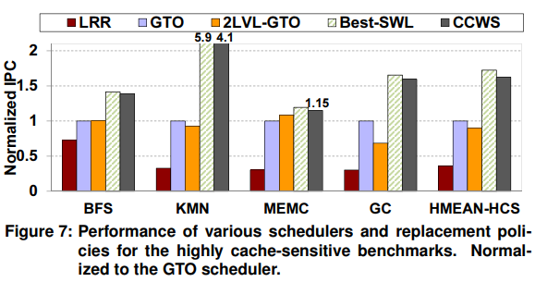
Cache Conscious Wavefront Scheduling ( Rogers et. al 2012 )
An improved GPU Scheduler
CCWS improves temporal locality in GPU caches.
Performance improvement in cache sensitive workloads by reducing cache thrashing.
Original work used vISA
mISA was not supported in simulator
Implemented the work in GPGPU-Sim v3.2.2, same configuration
Evaluate:
What if the work had used mISA?
Would the results be different than reported earlier?
Figure from original MICRO 12 paper

Slide 25
Performance Prediction: vISA vs mISA
BFS and GMV improve with CCWS
Cache thrashing caused by global memory loads
Similar across the two ISAs.
HOT and BS see improvement of 7% and 25% only in mISA simulations.
Apps limited by register usage per thread
Leads to register spilling to memory
These memory accesses cached in L1
Cause cache thrashing
This is improved by CCWS
PTX assumes infinite register space
vISA
mISA
College/DEPT. Arial Regular 12 point
Notes:
Kmeans – instructions are half in ptx+

Slide 26
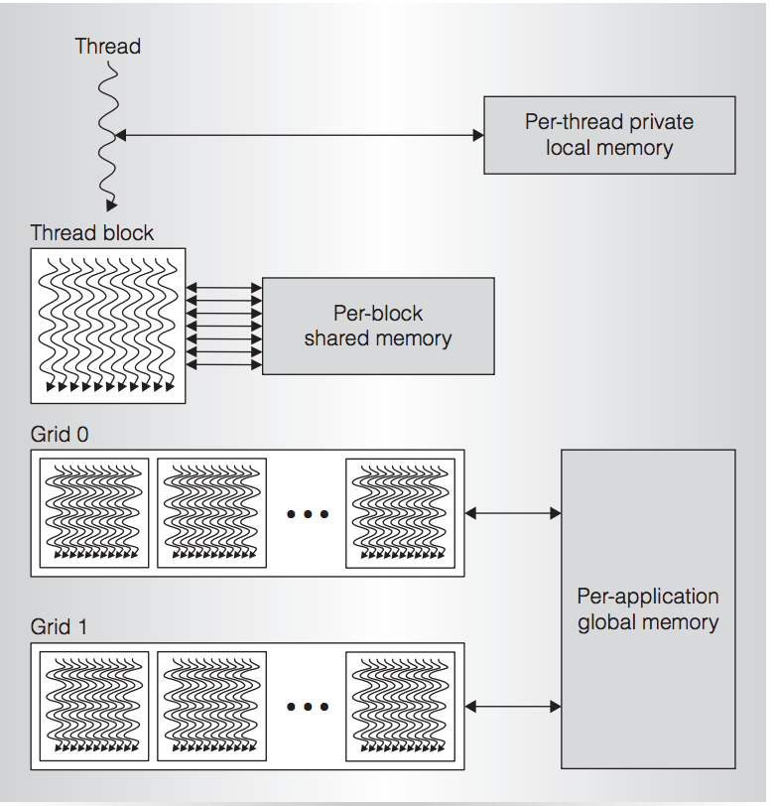
GPU Programming
SIMT Execution Model
Programmer sees MIMD threads (work-items)
Local+Shared+Global Memory
32 threads bundled together into a warp (64 w.i. in a wavefront) Basic unit of execution on a GPU
Multiple warps arranged in a Thread block (workgroup)
Shared+Global Memory
Thread blocks arranged in a Grid (ndRange)
Global Memory
Notes:
Backup

Slide 27
GPU ISAs studied
AMD
Nvidia
Virtual ISA
Machine ISA
Heterogeneous System Architecture Intermediate Language (HSAIL).
Graphics Core Next Gen3 (GCN3), a.k.a. Volcanic Islands (VI)
Contributed to AMD Paper submitted to MICRO 17
Parallel Thread eXecution (PTX)
Source and ASSembly (SASS).
To be submitted to SIGMETRICS 18 / ISPASS 18

Slide 28
GPU Simulators
AMD
Nvidia
HSAIL | GCN | PTX | SASS
 |  | Y; PTX v2.0 | GT200 (released in 2009)
Y | GCN3; Not released publicly
 | GCN1 | Y; PTX v3.0
 |  | Y; PTX v2.0
GPGPU-Sim
Gem5
Multi2Sim
GPUOcelot + MacSim

Slide 29
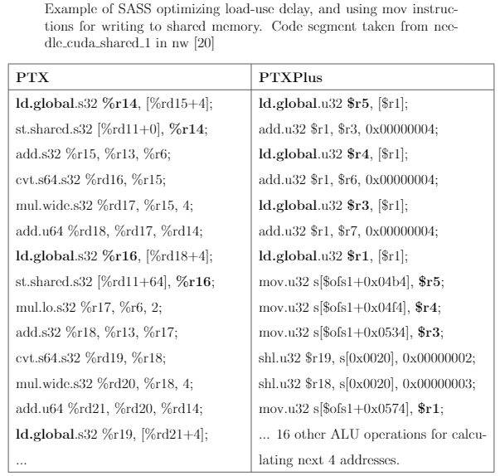
Code Example
Notes:
Highlight and then explain

Slide 30
Code Example
rem.s32 %r7, %r5, %r6; | mov.half.u32 $r1, s[0x0014]; mov.half.u32 $r0, $r2; callp l0x00000228; | l0x00000228: abs.u32 $r3, $r1; cvt.f32.u32 $r5, $r3; abs.u32 $r6, $r0; rcp.f32 $r7, $r5; cvt.rz.f32.u32 $r5, $r6; add.u32 $r7, $r7, 0xfffffffe; mul.rz.f32 $p0|$r5, $r5, $r7; cvt.rz.u32.f32 $r5, $r5; mul.wide.u16 $r8, $r3.lo, $r5.hi; mad.wide.u16 $r8, $r3.hi, $r5.lo, $r8; shl.u32 $r8, $r8, 0x00000010; mad.wide.u16 $r8, $r3.lo, $r5.lo, $r8; add.u32 $r8, $r6, -$r8; cvt.rz.f32.u32 $r8, $r8; mul.rz.f32 $p0|$r7, $r8, $r7; cvt.rz.u32.f32 $r7, $r7; add.u32 $r5, $r5, $r7; mul.wide.u16 $r7, $r5.hi, $r3.lo; mad.wide.u16 $r7, $r5.lo, $r3.hi, $r7; shl.u32 $r7, $r7, 0x00000010; mad.wide.u16 $r7, $r5.lo, $r3.lo, $r7; add.u32 $r7, -$r7, $r6; set.le.u32.u32 $r7, $r3, $r7; add.u32 $r5, -$r7, $r5; mul.wide.u16 $r7, $r5.hi, $r3.lo; mad.wide.u16 $r7, $r5.lo, $r3.hi, $r7; shl.u32 $r7, $r7, 0x00000010; mad.wide.u16 $r3, $r5.lo, $r3.lo, $r7; shr.u32 $r0, $r0, 0x0000001f; add.u32 $r5, -$r3, $r6; cvt.s32.s32 $r3, -$r0; xor.b32 $r3, $r3, $r5; set.ne.s32.s32 $p0/$o127, $r1, $r124; add.u32 $r0, $r0, $r3 @$p0.equ not.b32 $r0, $r1; retp; nop;
Integer division operations
in srad2 kernel in SRD1
div.s32 %r9, %r5, %r6; | mov.half.u32 $r1, s[0x0014]; mov.u32 $r0, $r2; callp l0x00000350; | l0x00000350: abs.u32 $r2, $r1; cvt.f32.u32 $r5, $r2; abs.u32 $r6, $r0; rcp.f32 $r7, $r5; cvt.rz.f32.u32 $r5, $r6; add.u32 $r7, $r7, 0xfffffffe; mul.rz.f32 $p0|$r5, $r5, $r7; cvt.rz.u32.f32 $r5, $r5; mul.wide.u16 $r8, $r2.lo, $r5.hi; mad.wide.u16 $r8, $r2.hi, $r5.lo, $r8; shl.u32 $r8, $r8, 0x00000010; mad.wide.u16 $r8, $r2.lo, $r5.lo, $r8; add.u32 $r8, $r6, -$r8; cvt.rz.f32.u32 $r8, $r8; mul.rz.f32 $p0|$r7, $r8, $r7; cvt.rz.u32.f32 $r7, $r7; add.u32 $r5, $r5, $r7; mul.wide.u16 $r7, $r5.hi, $r2.lo; mad.wide.u16 $r7, $r5.lo, $r2.hi, $r7; shl.u32 $r7, $r7, 0x00000010; mad.wide.u16 $r7, $r5.lo, $r2.lo, $r7; add.u32 $r6, -$r7, $r6; set.le.u32.u32 $r2, $r2, $r6; xor.b32 $r0, $r1, $r0; shr.u32 $r0, $r0, 0x0000001f; add.u32 $r5, -$r2, $r5; cvt.s32.s32 $r2, -$r0; xor.b32 $r2, $r2, $r5; set.ne.s32.s32 $p0/$o127, $r1, $r124; add.u32 $r0, $r0, $r2; @$p0.equ not.b32 $r0, $r1; retp; nop;
rem.s32 %r7, %r5, %r6; | mov.half.u32 $r1, s[0x0014]; mov.half.u32 $r0, $r2; callp l0x00000228; | l0x00000228: abs.u32 $r3, $r1; cvt.f32.u32 $r5, $r3; abs.u32 $r6, $r0; rcp.f32 $r7, $r5; cvt.rz.f32.u32 $r5, $r6; add.u32 $r7, $r7, 0xfffffffe; mul.rz.f32 $p0|$r5, $r5, $r7; cvt.rz.u32.f32 $r5, $r5; mul.wide.u16 $r8, $r3.lo, $r5.hi; mad.wide.u16 $r8, $r3.hi, $r5.lo, $r8; shl.u32 $r8, $r8, 0x00000010; mad.wide.u16 $r8, $r3.lo, $r5.lo, $r8; add.u32 $r8, $r6, -$r8; cvt.rz.f32.u32 $r8, $r8; mul.rz.f32 $p0|$r7, $r8, $r7; cvt.rz.u32.f32 $r7, $r7; add.u32 $r5, $r5, $r7; mul.wide.u16 $r7, $r5.hi, $r3.lo; mad.wide.u16 $r7, $r5.lo, $r3.hi, $r7; shl.u32 $r7, $r7, 0x00000010; mad.wide.u16 $r7, $r5.lo, $r3.lo, $r7; add.u32 $r7, -$r7, $r6; set.le.u32.u32 $r7, $r3, $r7; add.u32 $r5, -$r7, $r5; mul.wide.u16 $r7, $r5.hi, $r3.lo; mad.wide.u16 $r7, $r5.lo, $r3.hi, $r7; shl.u32 $r7, $r7, 0x00000010; mad.wide.u16 $r3, $r5.lo, $r3.lo, $r7; shr.u32 $r0, $r0, 0x0000001f; add.u32 $r5, -$r3, $r6; cvt.s32.s32 $r3, -$r0; xor.b32 $r3, $r3, $r5; set.ne.s32.s32 $p0/$o127, $r1, $r124; add.u32 $r0, $r0, $r3 @$p0.equ not.b32 $r0, $r1; retp; nop;
Notes:
Focus on opt int ops
Simplified abstract instr is a better proxy than old unopt code
New ISA it seems to use less number of instructions for these operations

Slide 31
Workloads
Applications that worked on both PTX and PTXPlus.
29 compute applications (that spawn a total of 1797 kernels) from Rodinia benchmark suite [11], Nvidia Cuda SDK 4.2 [32], SHOC [13], Parboil [43] and GPU Polybench [20]
Type | IPC | L1 Miss | L2 Miss | Mem Util
cache-sensitive | Low | High | Mod | Low
memory-sensitive | Mod | High | High | High
compute-intensive | High | Mod | Mod | Mod
compute-balanced | Mod | Mod | Mod | Mod

Slide 32
Memory Divergence
128
255
Fully Coalesced Memory access
Single 128B cache block
Divergent Memory accesses
Four 128B cache blocks
Worst case: 32 cache blocks
128
256
1024
1152
Source: Prof. Rogers, ECE565

Slide 33

Summary
 | Application | Virtual ISA | Machine ISA
Dynamic Instructions | Measure of work; front-end of pipeline
Cycles | Execution Time
Data and Pipeline Stalls | Bottleneck Analysis
Instructions Per Cycle | Performance metric
SIMD Utilization | Control Flow; occupancy analysis
Memory Divergence | Memory System Optimizations
Level1 data cache
L2 and Memory Controller
Power | Energy Efficiency
Open Source Availability
College/DEPT. Arial Regular 12 point

Slide 34
Acknowledgements
Prof. Murali Annavaram (Shepherd) and the anonymous reviewers
Dr. Brad Beckmann – AMD Research
Accelerator Architecture Lab at Purdue (AALP)
Tsung Tai, Mengchi
Thank you for your guidance and help throughout!!

Slide 35
Limitations
7 years old Fermi architecture; latest available mISA in open source simulators.
Used GTX480 from eBay ☺
Hardware counters were off for small values
Mean across 10 runs on hardware to account for varying operating conditions

